Slide 1
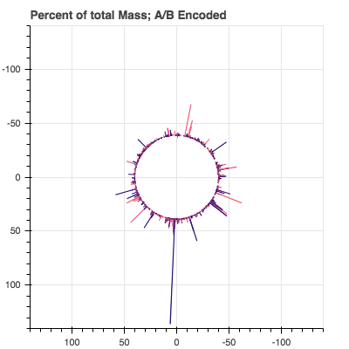
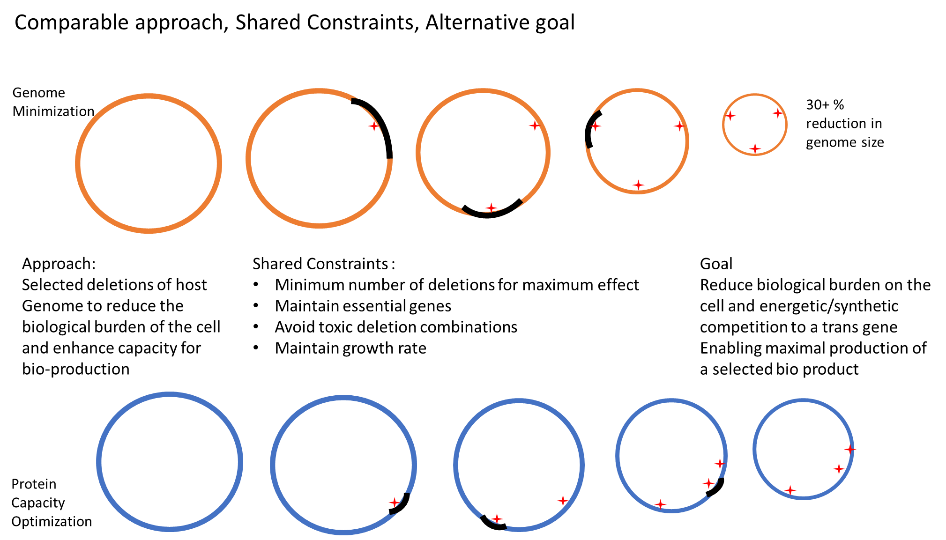
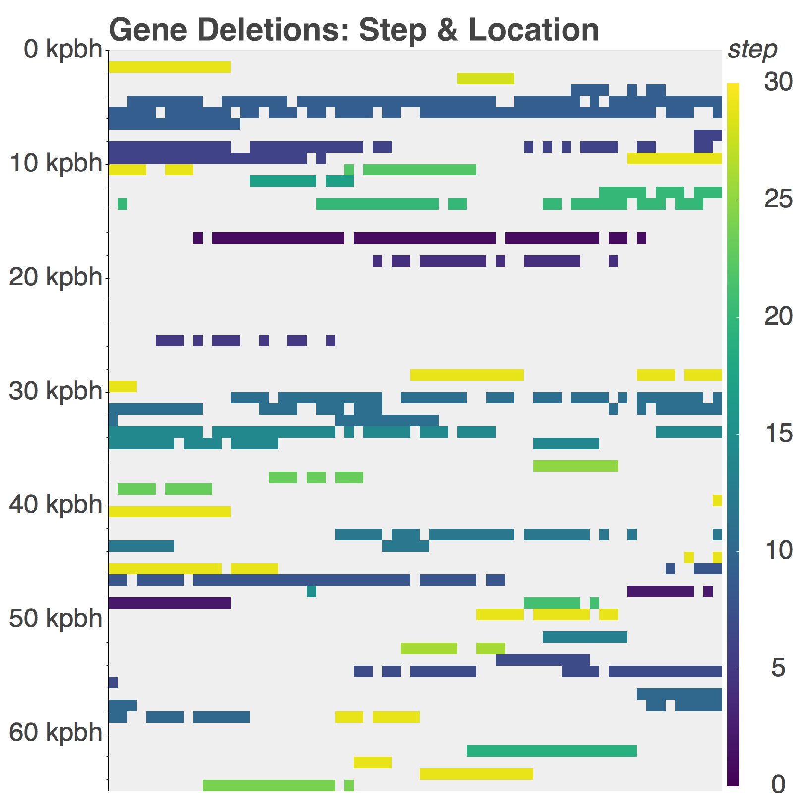
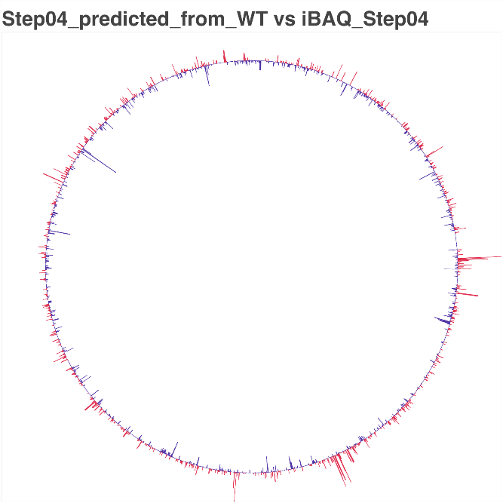
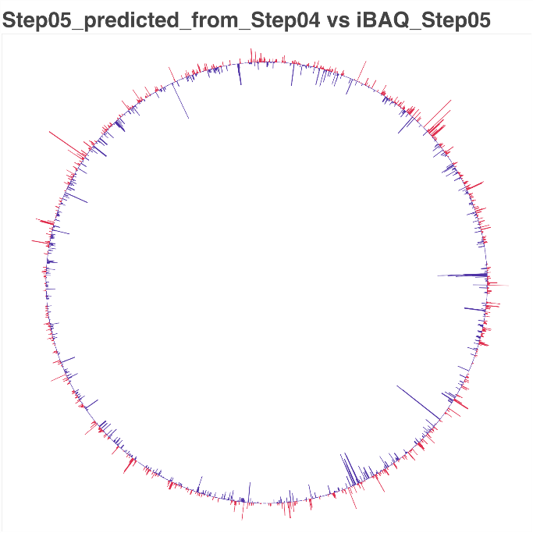
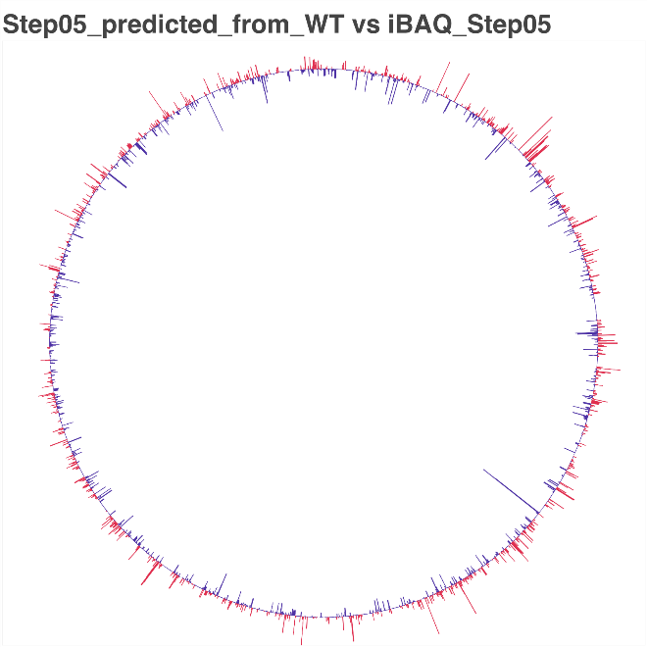
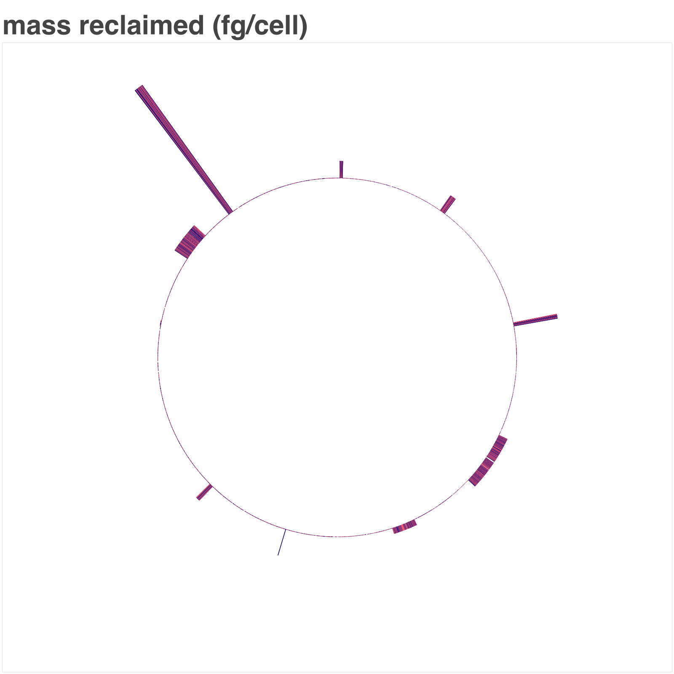
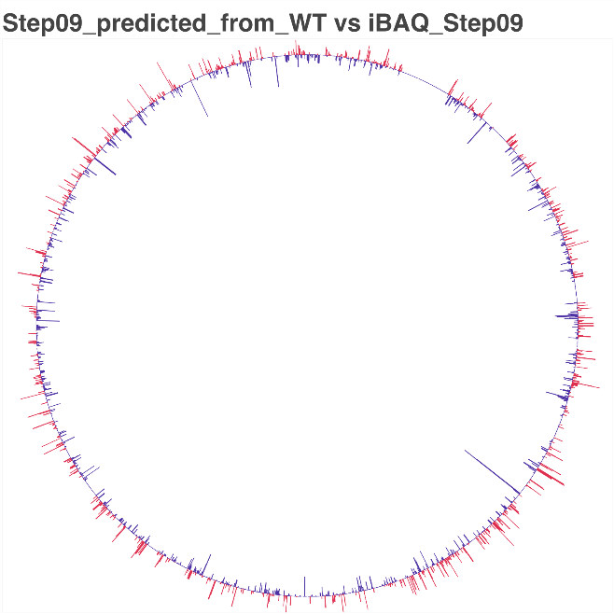
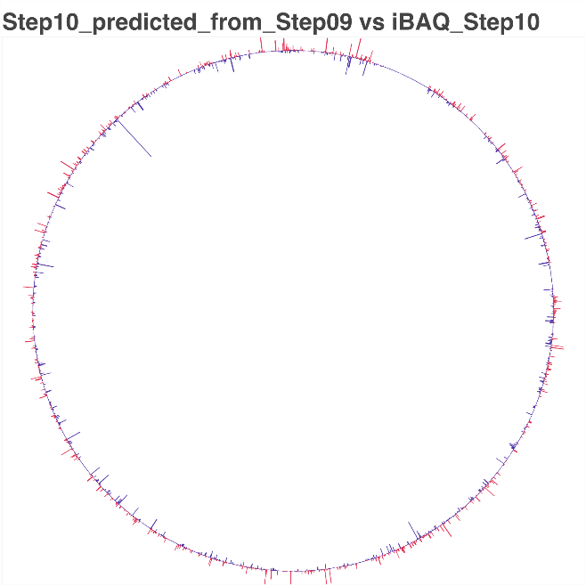
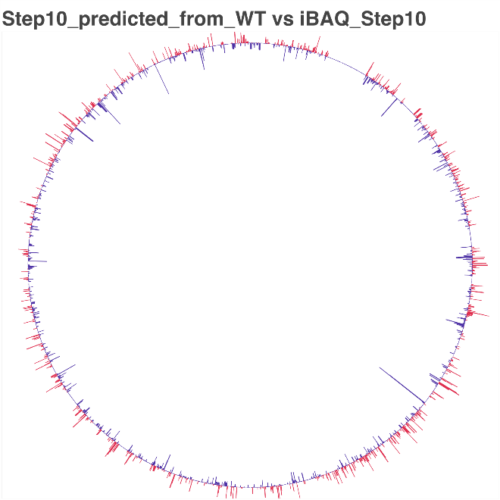
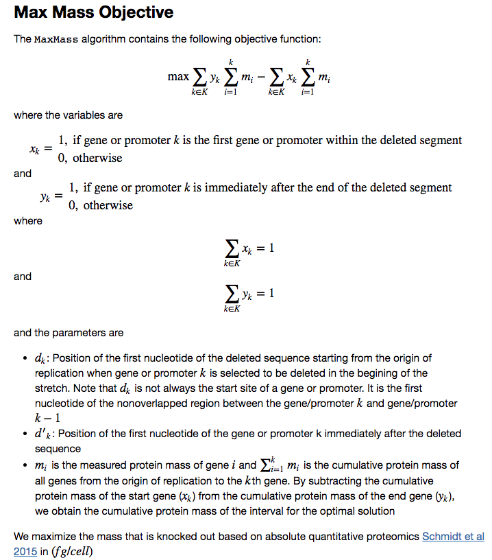
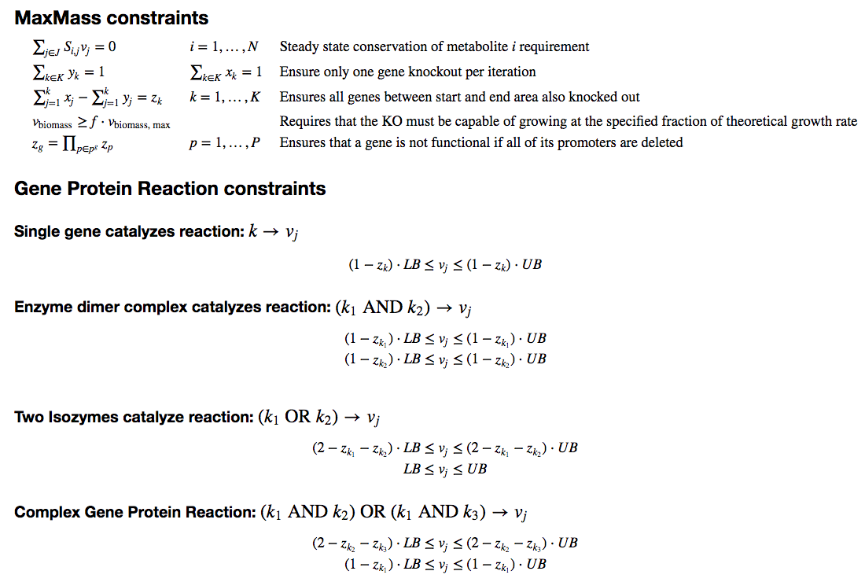
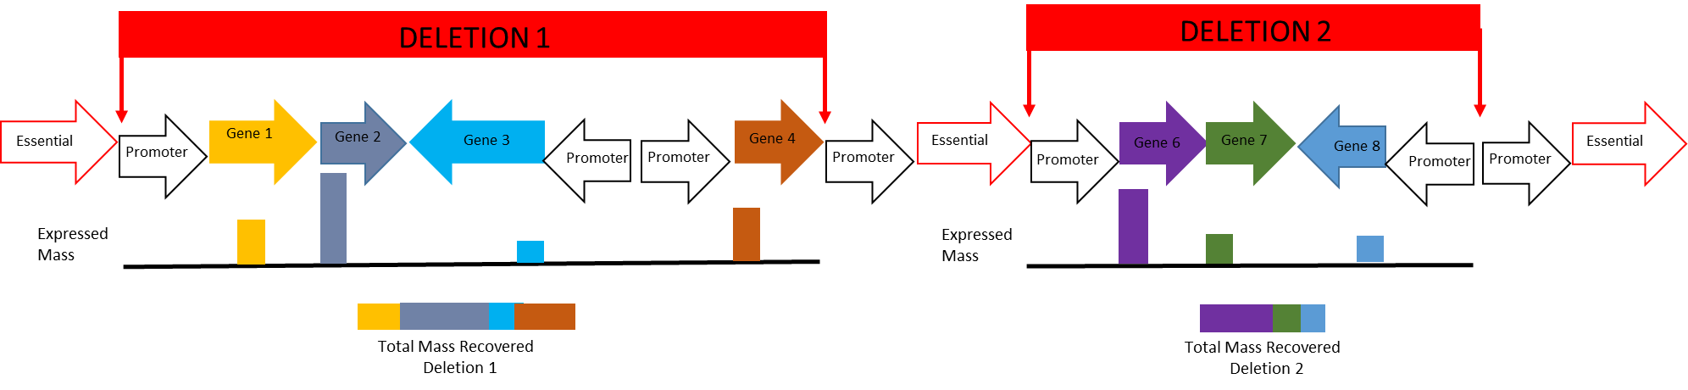

Optimal Protein Reclamation with MaxMass
Making Room for Bioproduction via Intelligent Reduction of the Host Proteome
Jeremy Zucker, Neeraj Kumar, Joseph Cottam, Jeremy Teuton, Robert Egbert
Introduction/Motivation:
Molecular crowding is a biophysical constraint on the ability of microbial cell factories to produce proteins of interest at sufficient titer, rate and yield to become economically viable. To address this issue directly, the Cellular Capacity Optimization project aims to iteratively knock out nonessential regions of the genome that code for highly expressed proteins in order to reclaim that protein capacity for engineered proteins. In order to rationally guide this process, we have developed MaxMass, an algorithm for iterative reduction of the host proteome without replacement. MaxMass automatically calculates which genes are essential for the current environment and iteration, and uses these essential genes as constraints on the size of the knockout region, while optimizing for maximum protein mass reclamation.
Results:
Comparison of Predictions with Experiment using proteomics of the KHK knockout collection
To evaluate the ability of the algorithm to predict protein reclamation, we used proteomics data obtained from the KHK collection of knockouts. As a baseline first step, we wished to assess how well the protein distribution of the previous step was able to predict the protein distribution of the subsequent step by assuming that the only expression that changed between steps were the genes that were knocked out. The results of this analysis are displayed in Figure XX. Interestingly, there were some proteins whose expression level increased as a result of the knockout.
Application of MaxMass to wild-type E. coli W3110
We then applied MaxMass using the protein expression from wild-type E. coli strain W3110 Schmidt et al 2018 in order to predict which gene knockouts would result in the largest amount of protein reclamation. The results for this experiment are displayed in Figure . We predicted that 48 fg protein/cell could be reclaimed after 10 steps.
Discussion/Future Directions:
Methods:
One interesting observation is that knocking out the most highly expressed proteins can result in new highly expressed proteins. To predict which proteins must be overexpressed in the knockout, future work will focus on extending the metabolic model with RNA and Protein expression mechanisms, known as ME-models. We will also extend this approach for other organisms such as Pseudomonas flourescens, Shewanella oneidensis MR-1 and E. coli Nissle.
File Name // File Date // PNNL-SA-#####
Notes:
NOTE: Print this poster file at 200% SCALE to result in a physical print measuring 60” wide x 42” tall. All type size notations shown above are based on the final printed size of the poster.
• Contact Digital Duplicating (375-2969, http://digitalduplicating.pnl.gov) to order poster printing and finishing services for your completed poster design.
• Remember to have your poster cleared for public display/distribution through the Information Release system (http://informationrelease.pnl.gov).
• Sidebar “About PNNL” box is considered optional, and can be removed if space is needed for technical content.

